Slide 1


A UNIT OF Sri Devraj Urs Educational Trust (R.) R L Jalappa Institute of Technology (Doddaballapur-561 203, Bangalore Rural Dist.,Karnataka State.) Approved by AICTE, New Delhi & Affiliated to VTU, Belagavi
DBMS Mini Project Presentation
on
”Project Name”
BY
Name1 (USN1)
Name2 (USN2)
Name3 (USN3)
Under the guidance of
Mrs. Veena K
Assistant Professor
Dept. of CSE
RLJIT.

Slide 2
CONTENTS
ABSTRACT
INTRODUCTION
DESIGN AND ANALYSIS
SYSTEM REQUIREMENTS
IMPLEMENTATION
SYSTEM TESTING
RESULTS
CONCLUSION
REFERENCENES

Slide 12
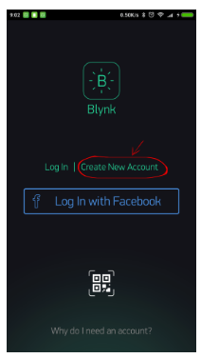
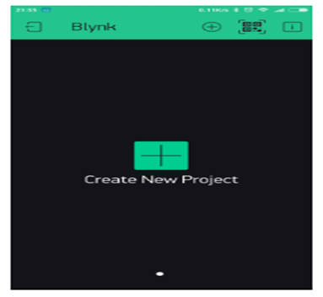
RESULTS
CREATE A BLYNK ACCOUNT
Create a New Project

Slide 13
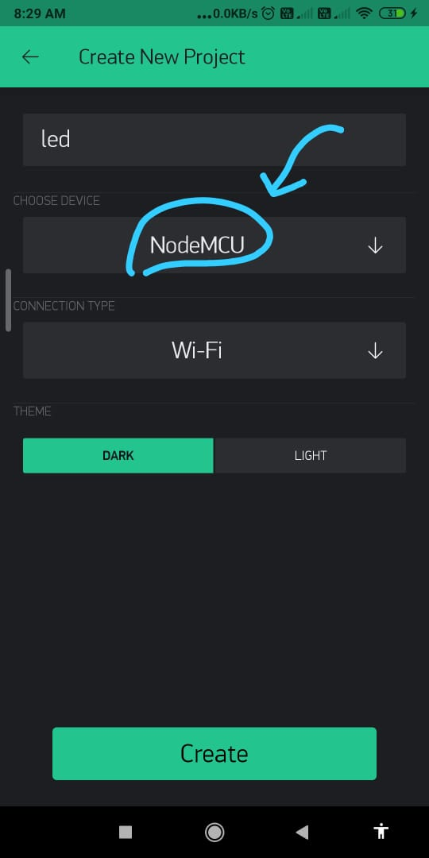
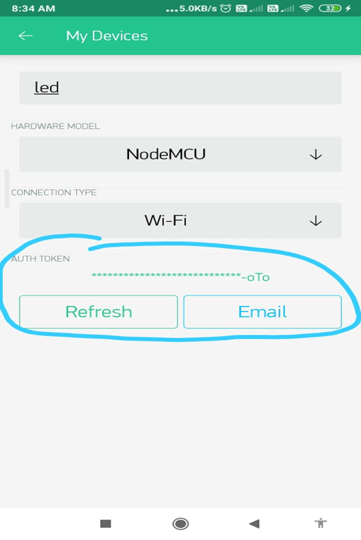
RESULTS
CHOOSE YOUR HARDWARE
Select the hardware model you will use.
You can also copy it manually. Click on devices section and selected required device. Auth token is sent to the registered email.

Slide 14
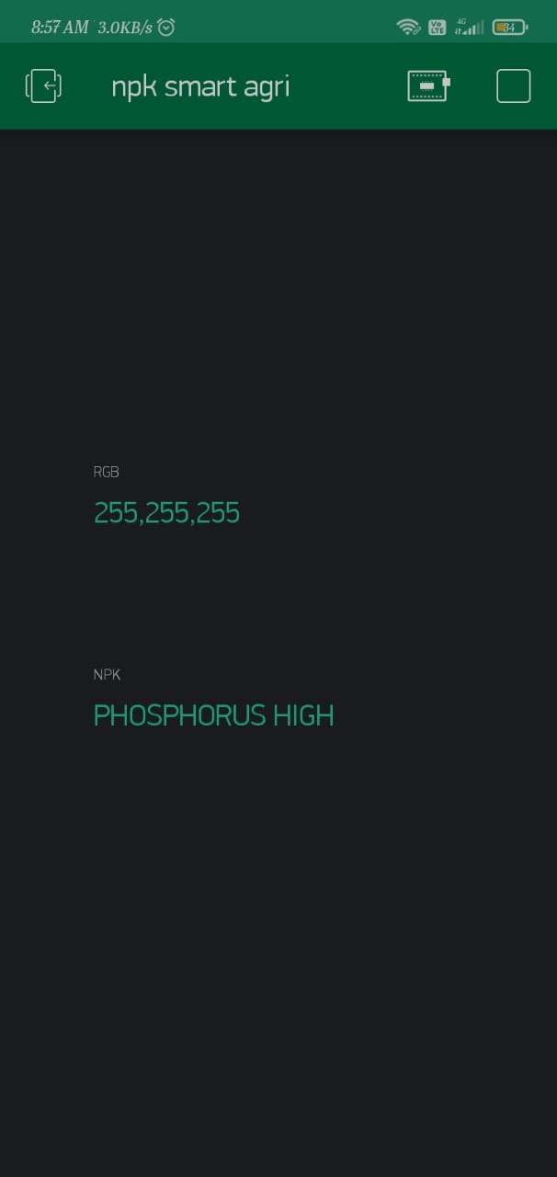
results

Slide 15
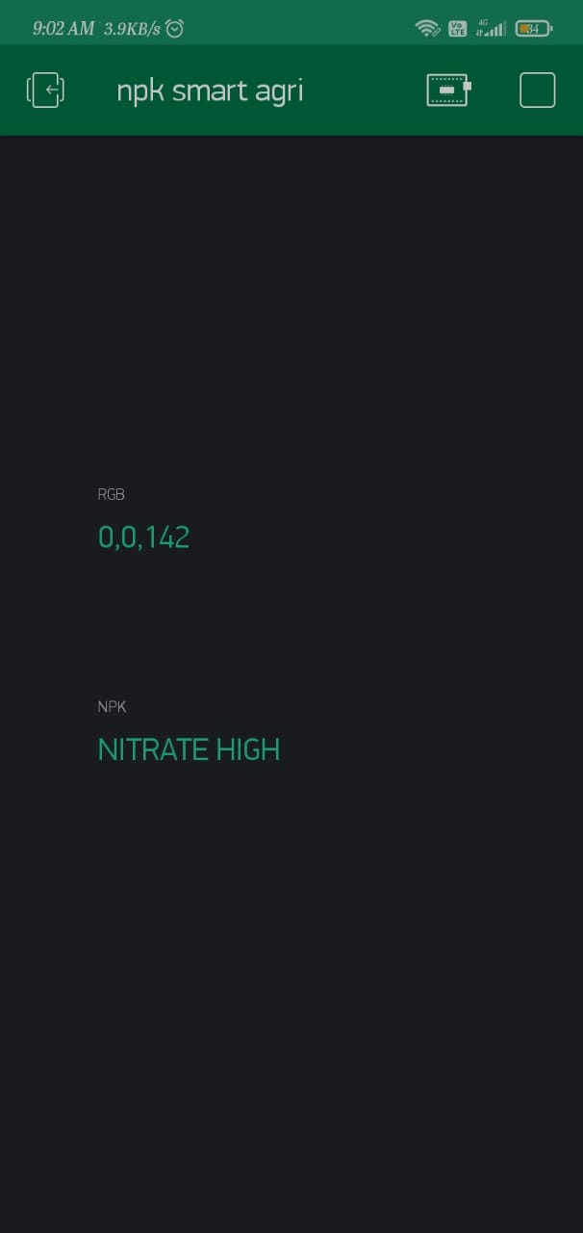
RESULTS

Slide 16
Conclusion

Slide 17
REFERENCES

Slide 18
THANK YOU

